Slide 1
Assignment 6: Socket Communication
Prepared by: Adithyan M P

Slide 2
Objective
Understand and document socket-based communication using AT commands.
Explore TCP/IP connectivity over cellular networks.
Study commands like AT+QIOPEN, AT+QISEND, AT+QICLOSE
Note: CelerSMS Emulator does not support these commands, so this is a theoretical assignment.

Slide 3
What is Socket Communication?
A socket enables a device to send and receive data over a network.
TCP sockets are used for reliable connections, e.g., sending data to a web server.
LTE and GSM modules can use AT commands to create and manage sockets.

Slide 4
Compatible Modules
Quectel EC25 (4G LTE)
SIM7600, BG96, SIM800 (2G/3G)
Modules must support TCP/IP stack and internet access.

Slide 5
Common Socket AT Commands (Quectel EC25)
Command | Description
AT+CGDCONT=1,"IP","airtelgprs.com" | Set APN (PDP context)
AT+QIACT=1 | Activate PDP context
AT+QIOPEN=1,0,"TCP","example.com",80,0,1 | Open TCP connection
AT+QISEND=0,20 | Send data over socket
AT+QICLOSE=0 | Close socket

Slide 6
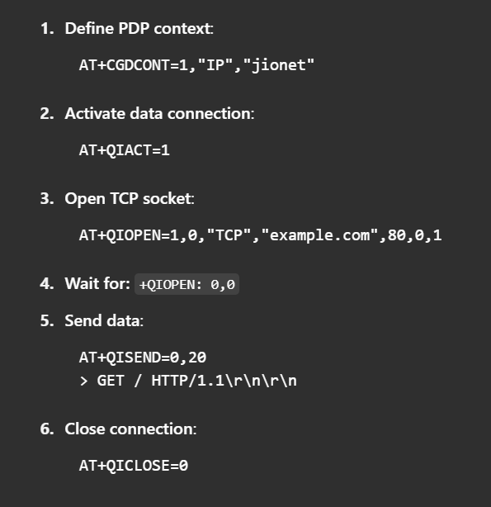
Step-by-Step Socket Setup

Slide 7
Expected Responses (Real Modem)
Command | Expected Response
AT+QIOPEN | +QIOPEN: 0,0 (success)
AT+QISEND | SEND OK
AT+QICLOSE | OK

Slide 8
Emulator Limitation
CelerSMS AT Emulator only supports GSM SMS commands.
Commands like AT+QIOPEN and AT+QISEND return ERROR.
This assignment is completed via research and documentation.

Slide 9
Applications in IoT
GPS trackers sending location to server.
Remote sensors uploading data to the cloud.
Smart meters reporting usage statistics.
Any M2M communication over cellular networks.

Slide 10
Conclusion
Socket AT commands are critical for internet-based data transmission
Understanding socket communication helps build connected IoT systems.
Emulator testing not possible; use real hardware for full validation.

